Slide 1

Understanding Climate Change with Machine Learning
ML Models for Weather Prediction
Analysis by Jeremy Obach for ClimateWins
15 MAY 2024

Slide 2
Objective
Use Machine learning to help predict the consequences of climate change.
Notes:
Context - data analyst at a European nonprofit organization “ClimateWins”

Slide 3

Proposed Hypotheses
Ongoing climate change is reducing the number of “pleasant weather” days in Europe, year over year.
Extreme weather events are increasing for coastal regions of Europe more than inland regions, year over year.
Weather stations in western Europe will observe a steeper decline in “pleasant weather” days than their counterparts in central and eastern Europe, year over year.
Notes:
Note: each of these 3 are alternatives to one another
With our ML-trained model, we should be able to assess the validity of these hypotheses.
Developing a Hypothesis: 1. Ask. Question, 2. Prelim research, 3.

Slide 4
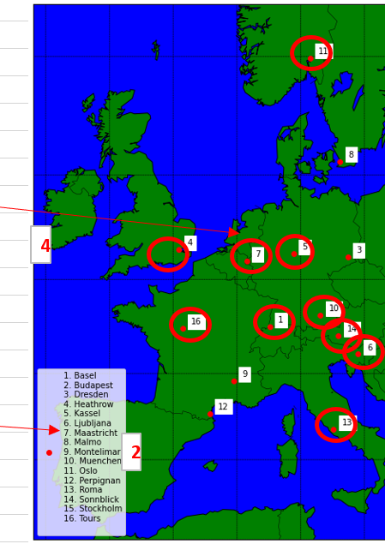
About the Data
Weather observations from 18 different weather stations across Europe.
BASEL, BELGRADE, BUDAPEST, DEBILT, DUSSELDORF, GDANSK, HEATHROW, KASSEL, LJUBLJANA, MAASTRICHT, MADRID, MUNICH, OSLO, ROMA, STOCKHOLM, TOURS, VALENCIA
Observations measured daily
Cloud cover, wind speed, humidity, pressure, global radiation, precipitation, snow depth, sunshine, mean temperature, min temperature, max temperature
Collected by the European Climate Assessment and Data Set Project
Notes:
Different weather stations may have varying collection standards.
Can lead to bias.
**Have a cloropleth or dots on map to demonstrate weather station locations**

Slide 5
Training the model
Additional dataset “pleasant_wx” used to train ML models on how to categorize days as unpleasant vs pleasant.
Criteria for its categorization worth investigation/scrutiny – determine bias.
Pleasant weather is ultimately subjective
Notes:
Expand into how bias could arise here, don’t assume they know about how Machine Learning works.
Criteria for pleasant wx set should be more transparent.

Slide 6
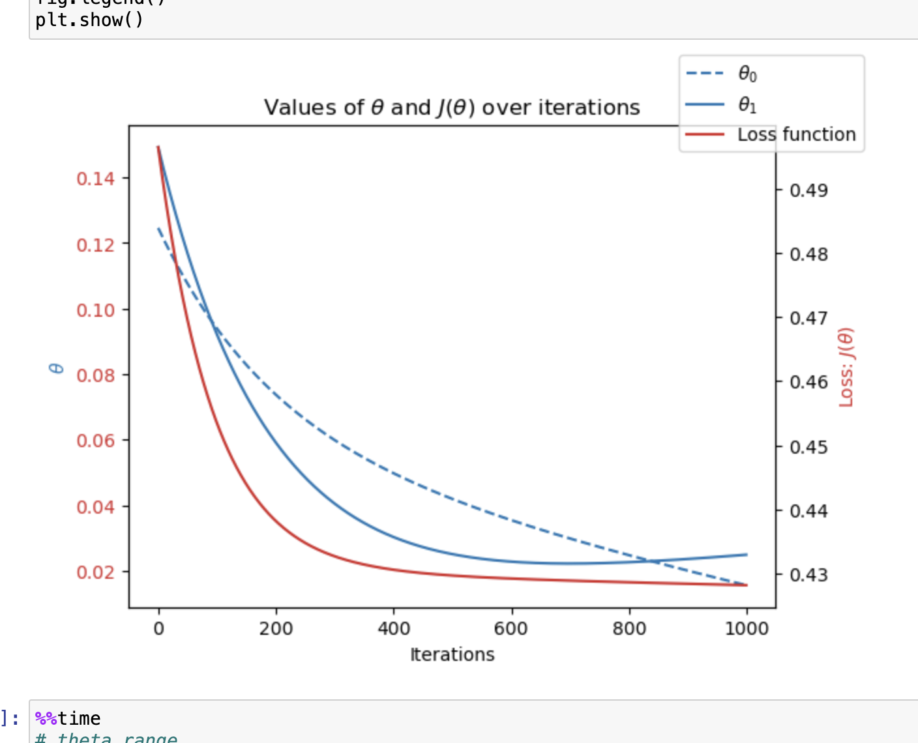
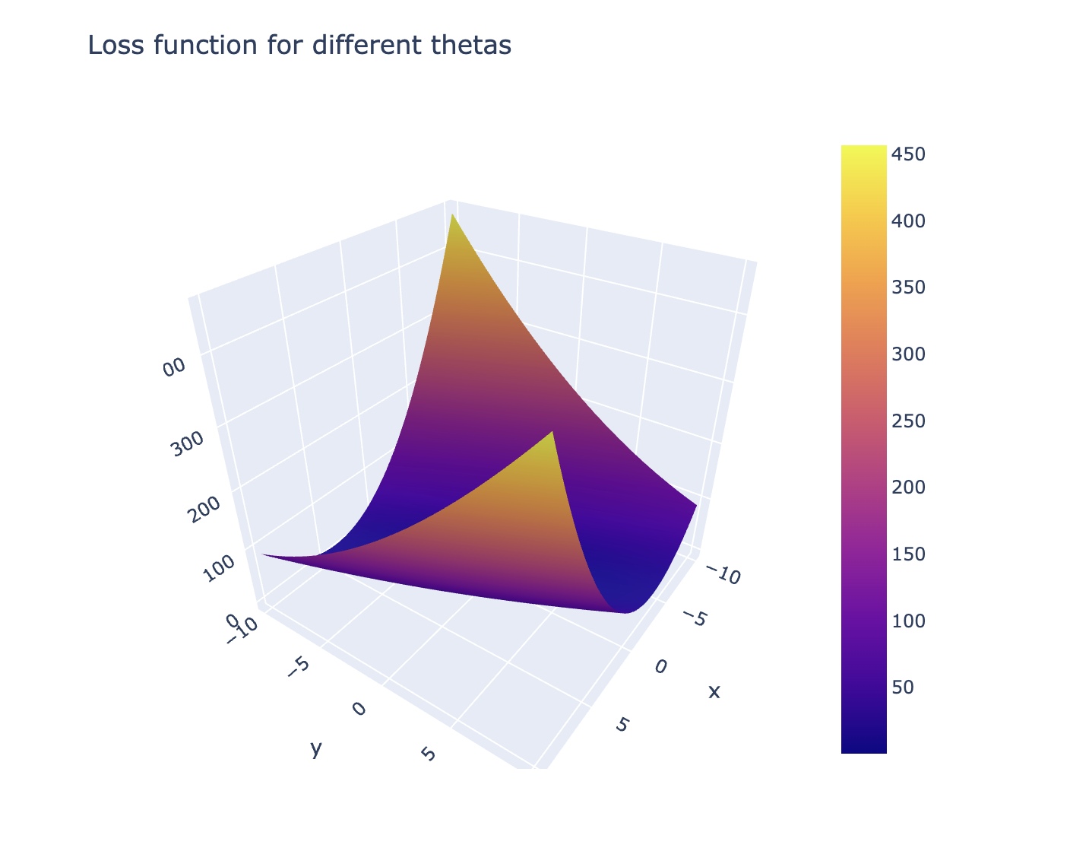
Gradient-Descent Optimization
Used to determine the features of the dataset;
Minimums and Maximums
Local and Global
Investigated city/year combinations:
Ljubliana 1974
Budapest 1989
Madrid 2000
Notes:
What is gradient descent optimization -> how do we find a ”goal”

Slide 7
Supervised Learning ML models used
K – Nearest Neighbors – algorithm that classifies datapoints based on the classification of a given number of nearby points.
Decision Tree - a list of forking branches that lead to an eventual classification.
Each decision narrows down a solution by asking for more and more specific information.
Artificial Neural Network – combination on inputs, nodes of hidden layers, and outputs.
Arguably the most sophisticated of the three.
Notes:
Define a “solution”, training an algorithm to correctly evaluate a pleasant day.
ANN – trying to model how the brain works

Slide 8
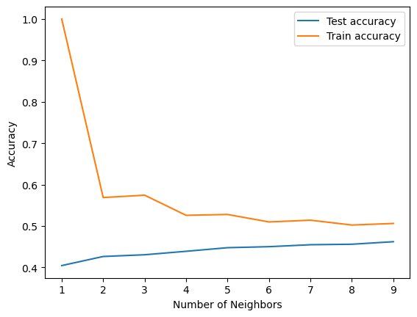
Supervised Learning ML models used
K – Nearest Neighbors ❌
Test Accuracy below 50%
Train Accuracy below 60% at 2 neighbors
Decision Tree ❌
Overfitting
Needs massive pruning
Artificial Neural Network ✅
Utilized 3 hidden layers (100,50,25 nodes) with 1000 iterations.
Yielded 88% train accuracy, 60% test accuracy.

Slide 9
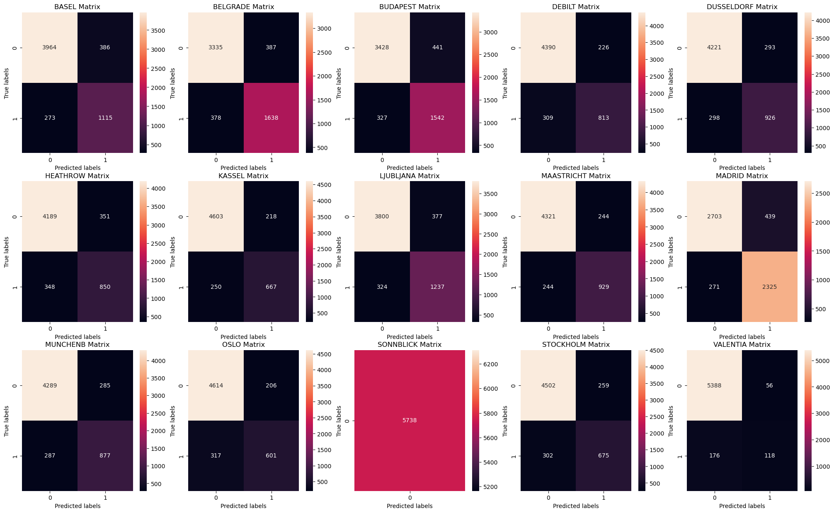
Confusion Matrix comparison
K – Nearest Neighbors – decent but not highly accurate.
Notes:
Confusion matrices. Notice decision tree is 100% accurate. This plus the tree model from last slid indicates massive overfit.

Slide 10
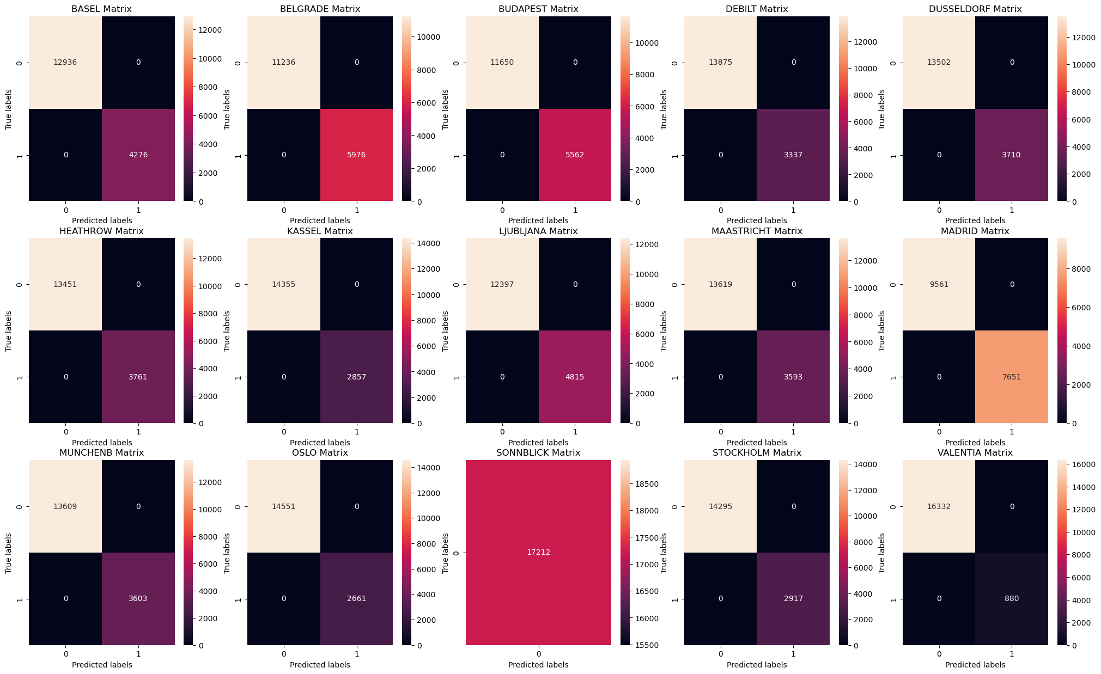
Confusion Matrix comparison
Decision Tree – 0 misplaced days due to massive overfitting. Wouldn’t be able to apply insights to new data.
Notes:
Confusion matrices. Notice decision tree is 100% accurate. This plus the tree model from last slid indicates massive overfit.

Slide 11
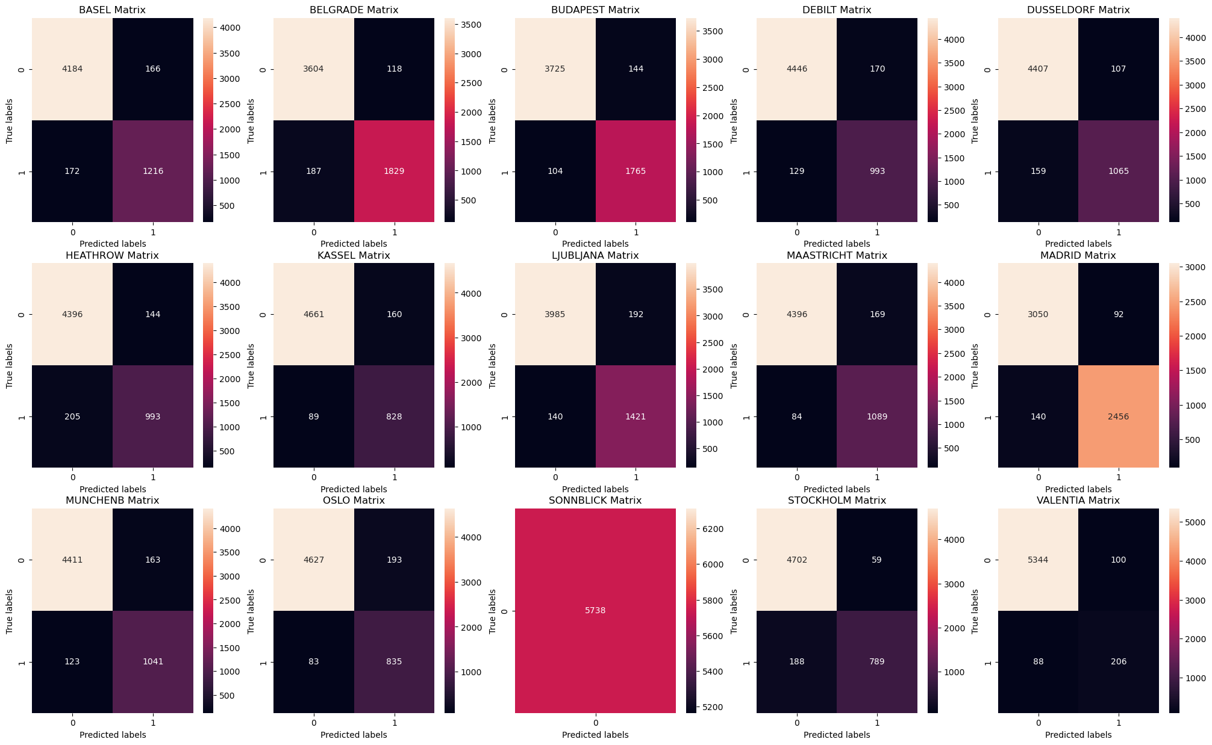
Confusion Matrix comparison
Artificial Neural Network – possible overfitting but not as prevalent as Decision Trees.
Balance of accuracy and applicability to new data
Notes:
Confusion matrices. Notice decision tree is 100% accurate. This plus the tree model from last slid indicates massive overfit.

Slide 12
Summary
Hypothesis – climate change is reducing pleasant days in EU
Methods chosen – Artificial Neural Network primarily
Next Steps – refine model, test with real data
Future Analysis – Implement Unsupervised ML techniques
Notes:
Hypotheses: Ongoing climate change is reducing the number of “pleasant weather” days in Europe, year over year.** main one
Extreme weather events are increasing for coastal regions of Europe more than inland regions, year over year.
Weather stations in western Europe will observe a steeper decline in “pleasant weather” days than their counterparts in central and eastern Europe, year over year.
Methods Chosen - ANN
Next Steps – refine ANN model, project out with model and test for real world accuracy.
Future Analysis –implement Unsupervised ML techniques, random forest, more powerful Unsupervised models.

Slide 13
Questions?
Contact me at Jeremy.Obach@gmail.com
or on LinkedIn –
www.linkedin.com/in/jeremy-obach
See the repository @
https://github.com/jobachone

